Slide 1
Notes:
Speaker’s Notes: This slide set was created to provide basic data trends and public health surveillance around alcohol-related harms in North Carolina. This presentation is not intended to cover all data related to alcohol-related harms. It includes information on statewide alcohol consumption, alcohol-related mortality, and key prevention strategies for excessive alcohol use and its related harms.
Feel free to incorporate these slides into your own presentations, grant proposals, reports, or any other way they may be useful. If this slide deck does not contain the information you need, please see our custom data request policy (https://injuryfreenc.dph.ncdhhs.gov/DataSurveillance/DataRequestPolicy.htm) and contact us at SubstanceUseData@dhhs.nc.gov.
Please read both the speaking and technical notes to ensure the data are presented in a consistent manner.

Slide 2
Technical Notes
Notes:
Speaker’s Notes: For more detailed technical notes on any of the data shared in this slide set, please contact us at SubstanceUseData@dhhs.nc.gov.

Slide 3
What is Excessive Alcohol Consumption?
Notes:
Speaker’s Notes: One drink is equivalent to a 12-ounce beer, a 5-ounce glass of wine, or a drink with one shot (1.5-ounce) of liquor.
Due to biological differences in body structure and chemistry, the definition of excessive drinking differs between men and women. After drinking the same amount of alcohol, most women tend to have higher blood alcohol levels and the immediate effects of alcohol usually occur more quickly and last longer in women than in men.
Excessive alcohol consumption is defined as binge drinking (4+ drinks in one sitting for women, 5+ for men), heavy drinking (8+ drinks in one week for women, 15+ for men), or any alcohol consumption by pregnant people or people under 21.

Slide 4
Excessive Alcohol Use in North Carolina
Notes:
Speaker’s Notes: Excessive alcohol use is the third leading preventable cause of death in North Carolina. Excessive alcohol use contributes to both acute health outcomes, like poisonings, motor vehicle traffic crashes, or other injuries and chronic health outcomes, such as liver disease, pancreatitis, and certain types of cancer. In 2021, there were over 6,300 alcohol attributable deaths in N.C. Excessive alcohol use costs the state over $9 billion each year.

Slide 5
Surveillance of Alcohol Consumption
Notes:
Speaker’s Notes: The North Carolina Division of Public Health and Department of Public Instruction conducts routine surveys to better understand alcohol consumption among adults and youth.

Slide 6
Notes:
Speaker’s Notes: Adult alcohol consumption is an important public health concern. Alcohol consumption can reduce individual lifespan and at the community level, impact adult productivity and unemployment, impacting community health overall. In 2021, 50% of adults in N.C. were current drinkers, which is roughly 4.1 million adults. Of those adults who drank, 29% (~1.3 million adults) said that they binge drank (4+ drinks in one sitting for women, 5+ for men) at least one time per month. 11% (~450,000 adults) of all adult drinkers said they drank heavily (8+ drinks in one week for women, 15+ for men).
Technical notes: These data come from the Behavioral Risk Factor Surveillance System Survey (BRFSS). This is a yearly, random telephone survey of N.C. adults 18+ years old. Information is collected in a routine, standardized manner on a variety of health behaviors and preventive health practices, such as cardiovascular disease, cancer, diabetes, and injuries. BRFSS interviews are conducted year-round, and data are analyzed annually; a variety of yearly analyses are available at: https://schs.dph.ncdhhs.gov/data/brfss/survey.htm .

Slide 7
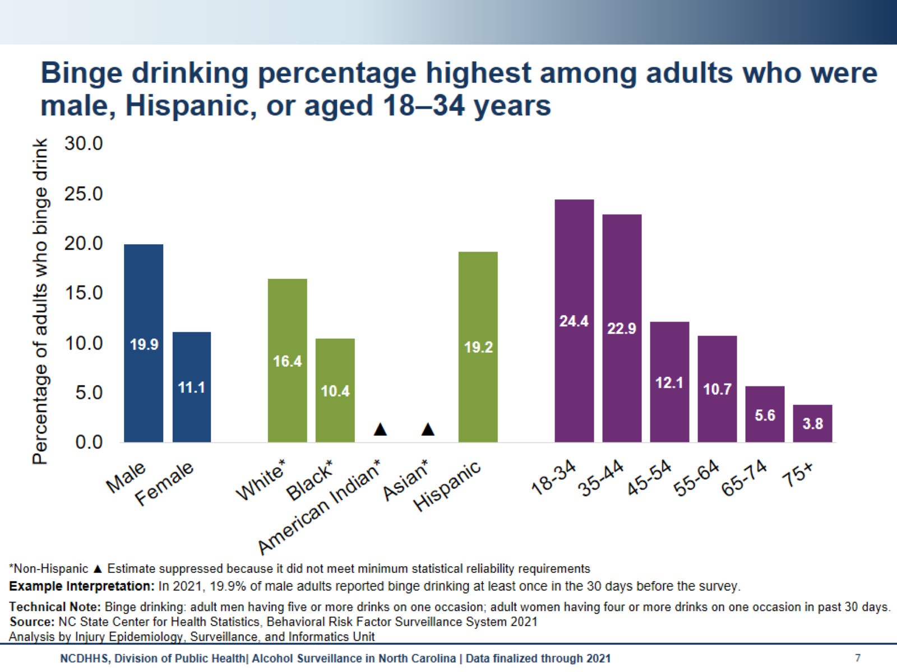
Binge drinking percentage highest among adults who were male, Hispanic, or aged 18–34 years
Notes:
Speaker’s Notes: A higher percentage of adults who were male, Hispanic, or aged 18–34 years reported binge drinking.
Technical notes: The percentages of adults who were American Indian non-Hispanic (NH) or Asian NH were suppressed due to estimates not meeting minimum statistical reliability requirements . Due to suppression, differences in binge drinking prevalence between race/ethnicity is not fully understood in N.C. Binge drinking is the most common and costly pattern of excessive alcohol use. This does not give the full magnitude of adult binge drinking prevalence and subsequent related health outcome disparities among various demographic groups.
These data come from the Behavioral Risk Factor Surveillance System Survey (BRFSS). This is a yearly, random telephone survey of N.C. adults 18+ years old. Information is collected in a routine, standardized manner on a variety of health behaviors and preventive health practices, such as cardiovascular disease, cancer, diabetes, and injuries. BRFSS interviews are conducted year-round, and data are analyzed annually; a variety of yearly analyses are available at: https://schs.dph.ncdhhs.gov/data/brfss/survey.htm .

Slide 8
Heavy drinking percentage highest among adults who were female, white*, or aged 35–44 years
Notes:
Speaker’s Notes: A higher percentage of adults who were female, white non-Hispanic (NH), or aged 35–44 years reported drinking heavily.
Technical notes: The percentages of adults who were American Indian NH or Asian NH were suppressed due to estimates not meeting minimum statistical reliability requirements . Due to suppression, differences in heavy drinking prevalence between race/ethnicity is not fully understood in N.C. This does not give the full magnitude of adult heavy drinking prevalence and subsequent related health outcome disparities among various demographic groups.
These data come from the Behavioral Risk Factor Surveillance System Survey (BRFSS). This is a yearly, random telephone survey of N.C. adults 18+ years old. Information is collected in a routine, standardized manner on a variety of health behaviors and preventive health practices, such as cardiovascular disease, cancer, diabetes, and injuries. BRFSS interviews are conducted year-round, and data are analyzed annually; a variety of yearly analyses are available at: https://schs.dph.ncdhhs.gov/data/brfss/survey.htm .

Slide 9
Notes:
Speaker’s Notes: Understanding current alcohol use among underage (<21 years old) drinkers helps develop appropriate public health interventions. Underage alcohol use puts youth at a higher risk of injury, including motor vehicle crashes, suicide, sexual assault, and high-risk sex. In 2021, 19% of high school students in N.C. said they were currently drinking alcohol. Of those high school students who drank, 50% binge drank, 36% usually drank liquor, and 43% usually obtained alcohol by someone, such as family or friends, giving it to them versus buying it themselves.
Technical Notes: These data come from the Youth Risk Behavior Surveillance System (YRBSS), which is conducted every other year. It asks middle and high schoolers questions about their behaviors that impact their health now and in the future. Topics include violence, personal safety, physical activity, nutrition, mental health, tobacco, drugs and alcohol, protective factors and sexual behavior questions. A variety of biannual analyses available: https://sites.google.com/dpi.nc.gov/nchealthyschools/nc-healthy-schools-data/yrbs

Slide 10
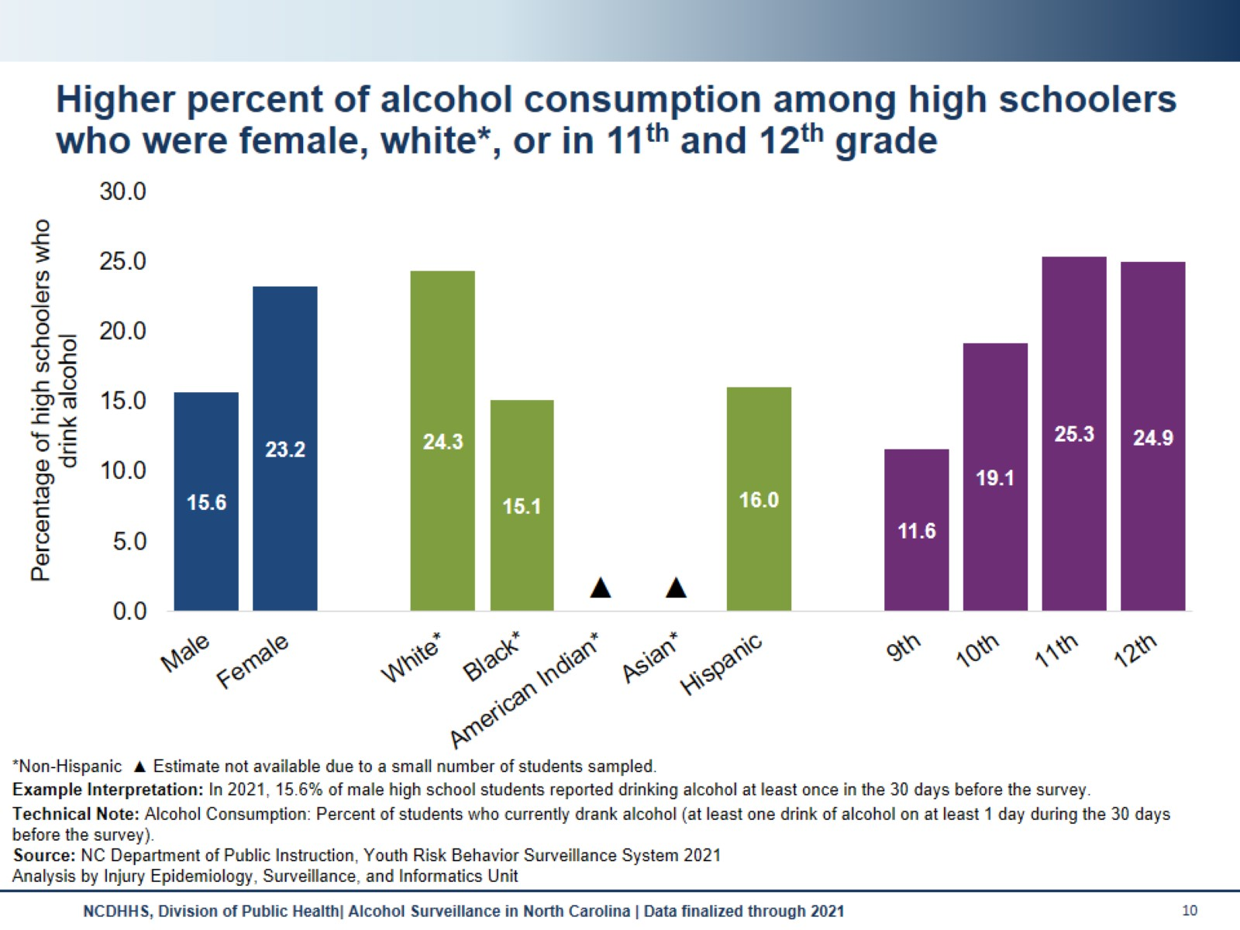
Higher percent of alcohol consumption among high schoolers who were female, white*, or in 11th and 12th grade
Notes:
Speaker’s Notes: A higher percentage of high schoolers who were female, white non-Hispanic (NH), or in 11th and 12th grade reported consuming alcohol.
Technical Notes: The percentages of high schoolers who were American Indian NH or Asian NH were not available due to a small number of students sampled. Due to the small sample, race/ethnicity differences in youth alcohol consumption prevalence is not fully understood in N.C. Youth who drink alcohol are more likely to experience school problems, social problems, disruption of development, violence, and many other alcohol-related outcomes. This does not give the full magnitude of youth alcohol consumption prevalence and subsequent related health outcome race/ethnicity disparities.
These data come from the Youth Risk Behavior Surveillance System (YRBSS), which is conducted every other year. It asks middle and high schoolers questions about their behaviors that impact their health now and in the future. Topics include violence, personal safety, physical activity, nutrition , mental health, tobacco, drugs and alcohol, protective factors and sexual behavior questions. A variety of biannual analyses available: https://sites.google.com/dpi.nc.gov/nchealthyschools/nc-healthy-schools-data/yrbs

Slide 11
Alcohol-Attributable Mortality
Notes:
Speaker’s Notes: N.C. State Center for Health Statistics death certificate data are also leveraged for alcohol surveillance by applying CDC’s Alcohol-Related Disease Impact (ARDI) methodology. Alcohol-related mortality refers to deaths that are fully or partially attributable to alcohol use. Fully alcohol-attributable deaths are those deaths that would not occur in the absence of alcohol, such as alcoholic liver disease or alcohol poisoning. Partially alcohol-attributable deaths are those deaths where alcohol is a contributing factor in a proportion of the deaths from those conditions, such as certain types of cancer and heart disease. For more information on the ARDI methodology, please visit https://nccd.cdc.gov/DPH_ARDI/default/default.aspx.

Slide 12
In 2021, an average of 17 North Carolinians died each day from a death attributable to excessive alcohol use.
Notes:
Speaker’s Notes: In 2021, there were 6,330 alcohol-attributable deaths in North Carolina. That is an average of 17 North Carolinians dying each day from a death attributable to excessive alcohol use (binge drinking, heavy drinking, any alcohol use by those under the age of 21 or pregnant people).
Technical Notes: Alcohol-attributable deaths include deaths from both acute and chronic causes of death due to excessive use of alcohol. The Alcohol-Related Disease Impact (ARDI) methodology is used to calculate estimates over a specified period, usually 5 years. The methodology is not set up to examine trends over time due to year-to-year variations in these estimates that may not be due to alcohol consumption. All estimates are currently based on alcohol consumption patterns of 2015-2019. All death estimates are directly related to alcohol, but estimates are calculated with either direct or indirect alcohol-attributable fractions (AAFs). Direct AAFs are based on scientific studies that have directly measured the relationship between excessive alcohol consumption and a given health outcome. Indirect AAFs use pooled risk estimates obtained from meta-analyses on the relationship between alcohol and various causes as well as data on the prevalence of alcohol consumption at specific levels. All AAFs, except the AAF for motor vehicle crashes, are national, not state-specific. For more information on the ARDI methodology, please visit https://nccd.cdc.gov/DPH_ARDI/default/default.aspx.

Slide 13
Examples of Alcohol-Attributable Deaths
Notes:
Speaker’s Notes: Of the alcohol-attributable deaths, some causes of death are immediate (acute), like falls, motor vehicle crashes, or alcohol poisonings and can result from a single alcohol consumption event like binge drinking (4+ drinks in one sitting for women, 5+ for men). However, the majority of the alcohol-attributable deaths are due to chronic conditions, often resulting from long-term excessive alcohol consumption. Some, like alcohol abuse or alcohol-induced pancreatitis, are 100% attributable to alcohol consumption, while others, like liver disease, certain cancers, and strokes, are partially attributable to alcohol consumption.
Technical Notes: Estimates are calculated for 58 acute and chronic causes of death using alcohol-attributable fractions (AAF). AAFs are used to express the extent to which alcohol consumption contributes to a health outcome. All death estimates are directly related to alcohol, but estimates are calculated with either direct or indirect AAFs. Direct AAFs are based on scientific studies that have directly measured the relationship between excessive alcohol consumption and a given health outcome. Indirect AAFs use pooled risk estimates obtained from meta-analyses on the relationship between alcohol and various causes as well as data on the prevalence of alcohol consumption at specific levels. All AAFs, except the AAF for motor vehicle crashes, are national, not state-specific. For more information on the Alcohol-Related Disease Impact (ARDI) methodology, please visit https://nccd.cdc.gov/DPH_ARDI/default/default.aspx.

Slide 14
Alcohol-attributable death rates are increasing in NC
Notes:
Speaker’s Notes: Using CDC’s Alcohol-Related Disease Impact (ARDI) methodology, the alcohol-attributable death rate was 59.7 deaths per 100,000 population in 2021, an estimated 6,330 deaths. Alcohol-attributable death rates have increased 64% since the 2012 death rate of 36.4 deaths per 100,000 population, an estimated 3,553 deaths.
Technical Notes: The N.C. Division of Public Health Alcohol Data Dashboard (https://dashboards.ncdhhs.gov/t/DPH/views/AlcoholDashboard_2020Update_04042021/Story?%3Aembed=y&%3AisGuestRedirectFromVizportal=y
) and Alcohol Data Page (https://injuryfreenc.dph.ncdhhs.gov/DataSurveillance/alcohol.htm) share county level estimates of acute, chronic, and total alcohol attributable deaths. All death estimates are directly related to alcohol, but estimates are calculated with either direct or indirect alcohol-attributable fractions (AAFs). Direct AAFs are based on scientific studies that have directly measured the relationship between excessive alcohol consumption and a given health outcome. Indirect AAFs use pooled risk estimates obtained from meta-analyses on the relationship between alcohol and various causes as well as data on the prevalence of alcohol consumption at specific levels. All AAFs, except the AAF for motor vehicle crashes, are national, not state-specific. For more information on the Alcohol-Related Disease Impact (ARDI) methodology, please visit https://nccd.cdc.gov/DPH_ARDI/default/default.aspx. Due to changes within the N.C. State Center for Health Statistics (SCHS), the 2021 population file is currently on hold. The 2020 population was used as a proxy for 2021 population estimates using data from the Vital Registry System of the N.C. SCHS. Rates will be subject to change until a new file is created.

Slide 15
Leading causes of alcohol-attributable deaths in NC are poisonings (not alcohol), alcoholic liver disease, and motor vehicle traffic crashes
Notes:
Speaker’s Notes: 1,151 of alcohol-attributable deaths in 2021 were due to poisonings (not alcohol), which are deaths that involve another substance in addition to a high blood alcohol concentration (e.g., and opioid overdose that also involved alcohol). Poisoning (not alcohol) alcohol-attributable deaths were 18% of all alcohol-attributable deaths in 2021.
Technical Notes: Estimates are calculated for 58 acute and chronic causes of death using alcohol-attributable fractions (AAF). AAFs are used to express the extent to which alcohol consumption contributes to a health outcome. All death estimates are directly related to alcohol, but estimates are calculated with either direct or indirect AAFs. Direct AAFs are based on scientific studies that have directly measured the relationship between excessive alcohol consumption and a given health outcome. Indirect AAFs use pooled risk estimates obtained from meta-analyses on the relationship between alcohol and various causes as well as data on the prevalence of alcohol consumption at specific levels. All AAFs, except the AAF for motor vehicle crashes, are national, not state-specific. For more information on the Alcohol-Related Disease Impact (ARDI) methodology, please visit https://nccd.cdc.gov/DPH_ARDI/default/default.aspx.

Slide 16
Alcohol-attributable death rates highest among individuals who were male, American Indian*, or aged 65 years and older
Notes:
Speaker’s Notes: Looking the most recent five years of available data (2017-2021), we can analyze descriptive trends within these alcohol-attributable deaths. Males have a higher rate of alcohol attributable deaths, at 72.2 per 100,000 population, compared with females at a little under half of that. Rates of alcohol-attributable death increased by age group. Even though the percent of older adults who report excessive drinking is low, the rates of alcohol-related death are high among this group. This is because the Alcohol-Related Disease Impact (ARDI) methodology, considers both chronic and acute causes of death that are attributable to alcohol. American Indian non-Hispanic (NH) residents have a higher rate of alcohol attributable death, at 75.5 per 100,000 population, with the next highest group being white NH residents at 55.5 per 100,000 population. Socioeconomic conditions and historical trauma have led to persistent racial and ethnic disparities. These inequities, along with other factors, have contributed to the observed health disparity in alcohol-attributable death rates.
Technical Notes: Rates were calculated for 2017 to 2021 by sex, age, and race/ethnicity using the ARDI methodology to estimate alcohol-attributable deaths. ARDI does not provide stratification by race/ethnicity, only by age and sex. Alcohol-attributable deaths for race/ethnicity may be high among one race/ethnicity due to a broader disparity in one of the 58 alcohol-attributable causes of death, and not necessarily attributable to alcohol's involvement. For example, one race/ethnicity may have a higher rate of drowning, which would lead to a higher alcohol-attributable rate estimate. In addition, with race/ethnicity data, demographic misclassifications could have occurred during the death certification process. For more information on the ARDI methodology, please visit https://nccd.cdc.gov/DPH_ARDI/default/default.aspx. Due to changes within the N.C. State Center for Health Statistics (SCHS), the 2021 population file is currently on hold. The 2020 population was used as a proxy for 2021 population estimates using data from the Vital Registry System of the N.C. SCHS. Rates will be subject to change until a new file is created.

Slide 17
Alcohol-attributable death rates due to acute and chronic causes are increasing in NC
Notes:
Speaker’s Notes: Using the Alcohol-Related Disease Impact (ARDI) methodology, From 2012 to 2021, rates increased for both chronic and acute causes of alcohol-attributable death, a 58% increase for chronic causes and a 71% increase for acute causes. For chronic causes, the rate increased from 20.7, an estimated 2,017 deaths, to 32.7, and estimated 3,471 deaths, per 100,000 population. For acute causes, the rate increased from 15.8, an estimated 1,536 deaths, to 27.0, an estimated 2,859 deaths, per 100,000 population.
Technical Notes: There is county level information on ARDI methodology (https://nccd.cdc.gov/DPH_ARDI/default/default.aspx) and alcohol-attributable deaths included in the N.C. Division of Public Health Alcohol Data Dashboard and in PDF tables posted on our injuryfreenc website (https://injuryfreenc.dph.ncdhhs.gov/DataSurveillance/alcohol.htm), which also breaks down chronic and acute estimates. Chronic alcohol-attributable deaths result from long-term, excessive use of alcohol. Acute alcohol-attributable deaths result from short-term, excessive use of alcohol. Due to changes within the N.C. State Center for Health Statistics (SCHS), the 2021 population file is currently on hold. The 2020 population was used as a proxy for 2021 population estimates using data from the Vital Registry System of the N.C. SCHS. Rates will be subject to change until a new file is created.

Slide 18
Individuals who were male and American Indian* had highest alcohol-attributable death rates for both acute and chronic causes
Notes:
Speaker’s Notes: Looking the most recent five years of available data (2017-2021), we can analyze descriptive trends within chronic and acute alcohol-attributable deaths. Chronic alcohol-attributable deaths increase with age, with a death rate of 82.2 per 100,000 population for people aged 65 and older. Among acute alcohol-attributable deaths, the death rate is highest among those aged 21 to 34, with 37.6 per 100,000 population.
Acute and chronic alcohol-attributable death rates were highest among American Indian non-Hispanic (NH), Black NH, and white NH residents. However, both American Indian NH and Black NH residents have higher acute alcohol-attributable death rates when compared to the corresponding chronic alcohol-attributable death rate. Among white NH residents, the chronic alcohol-attributable death rate is higher than the corresponding acute alcohol-attributable death rate. Socioeconomic conditions and historical trauma have led to persistent racial and ethnic disparities. These inequities, along with other factors, have contributed to the observed health disparity in both acute chronic alcohol-attributable death rates. Acute and chronic alcohol-attributable death rates were similar by sex, with male residents having higher rates than female residents.
Technical Notes: Rates were calculated for 2017 to 2021 by sex, age, and race/ethnicity. With race/ethnicity data, demographic misclassifications could have occurred during the death certification process. Alcohol-Related Disease Impact (ARDI) methodology only includes sex- and age-specific alcohol-attributable fractions, which aid in the calculation of alcohol attributable deaths. Race/ethnicity-specific alcohol-attributable fractions are not available. Due to alcohol-attributable fractions not being available by race/ethnicity, alcohol-attributable deaths may be higher amongst one race/ethnicity due to a broader disparity in one of the 58 alcohol-attributable causes of death, and not necessarily attributable to alcohol's involvement. For example, one race/ethnicity may have a higher rate of drowning, which would lead to a higher acute alcohol-attributable rate estimate. For more information on the ARDI methodology, please visit https://nccd.cdc.gov/DPH_ARDI/default/default.aspx. Due to changes within the N.C. State Center for Health Statistics (SCHS), the 2021 population file is currently on hold. The 2020 population was used as a proxy for 2021 population estimates using data from the Vital Registry System of the N.C. SCHS. Rates will be subject to change until a new file is created.

Slide 19
Alcohol-Related Cost
Notes:
Speaker’s Notes: Excessive alcohol use can also impact the economy of North Carolina.

Slide 20
Estimated One Year Economic Cost of Excessive Alcohol Consumption, 2017
Notes:
Speaker’s Notes: The economic cost of excessive alcohol consumption includes losses in productivity, healthcare costs, criminal justice expenses, and motor vehicle crashes for one year. Excessive alcohol consumption cost the state over $9 billion a year.
Technical Notes: The numbers generated in this slide were produced by Combs et. al, 2017 study, “The Societal Cost of Excessive Drinking in North Carolina, 2017” (https://pubmed.ncbi.nlm.nih.gov/35504714/).

Slide 21
Prevention Of Excessive Alcohol Consumption and Related Harms
Notes:
Speaker’s Notes: In light of these trends, there are numerous areas for prevention and reduction of excessive alcohol consumption and its related harms.

Slide 22
Community Preventive Services Task Force (CPSTF) recommendations to prevent excessive alcohol use and its related harms
Notes:
Speaker’s Notes: The Community Preventive Services Task Force recommends several evidence-based strategies for reducing excessive drinking and its related harm.
Technical Notes: The Community Preventive Services Task Force (CPSTF) is an independent, non-federal, volunteer body of public health and prevention experts. CPSTF provides recommendations and findings on programs, services, and other interventions to protect and improve population health. The recommendations and findings are based on systematic reviews of evidence on the effectiveness and economic impact. For more information on CPSTF and excessive alcohol use prevention strategies, please visit https://www.thecommunityguide.org/topics/excessive-alcohol-consumption.html.

Slide 23
Strategies to reduce excessive alcohol use and its related harms in NC
Notes:
Speaker’s Notes: The Community Preventive Services Task Force issued several evidence-based recommendations for reducing excessive drinking. This includes:
-Support and Maintain State-Controlled Alcohol Sales - State-controlled alcohol sales are recommended as an evidence-based strategy to minimize the number of off-premise alcohol retailers, which has been shown to decrease alcohol consumption.
-Increase Alcohol Taxes - Increase the unit price of alcohol by raising alcohol excise taxes.
-Limit the Days and Hours of Alcohol Sales - Maintain or decrease days and hours that alcohol is sold.
-Regulate Alcohol Outlet Density - Limit the number of businesses selling alcohol in neighborhoods.
-Support Dram Shop Liability - Laws that permit retail establishments to be held liable for injuries or harms caused by illegal service to intoxicated or underage customers.
-Increase Alcohol Screening and Brief Intervention - Screen every adult for excessive drinking using validated questions and have a brief conversation with those who screen positive.
Technical Notes: The Community Preventive Services Task Force (CPSTF) is an independent, non-federal, volunteer body of public health and prevention experts. CPSTF provides recommendations and findings on programs, services, and other interventions to protect and improve population health. The recommendations and findings are based on systematic reviews of evidence on the effectiveness and economic impact. For more information on CPSTF and excessive alcohol use prevention strategies, please visit https://www.thecommunityguide.org/topics/excessive-alcohol-consumption.html.

Slide 24
NC consumes less alcohol, but receives more revenue from alcohol sales than SC
Notes:
Speaker’s Notes: North Carolina is one of 17 states with state-controlled alcohol sales, while South Carolina has a privatized system. North Carolinians consume less alcohol than South Carolinians, and North Carolina receives more revenue from alcohol sales than South Carolina. North Carolina ranks 44th per capita in gallons consumed and 7th in revenue per gallon, while South Carolina, ranks 27th in consumption and 38th in revenue.

Slide 25
Dietary Guidelines for Americans
Notes:
Speaker’s Notes: The Dietary Guidelines for Americans recommends that all adults of legal age can choose not to drink. If you choose to drink, it is recommended to drink in moderation by limiting your intake to 2 drinks or less in a day for men or 1 drink or less in a day for women on days when alcohol is consumed. The guidelines recommend that some people should not drink at all. This includes people that are pregnant or may be pregnant, people that are younger than 21, people that have certain medical conditions or take certain medications that can interact with alcohol, people that are recovering from alcohol use disorder, and people that are unable to control the amount they drink.
Technical Note: The Dietary Guidelines for Americans provides advice on what to eat and drink to meet nutrient needs, promote health, and prevent disease. It is updated and released by the U.S. Department of Agriculture and U.S. Department of Health and Human Services every five years. Each edition reflects the current body of nutrition science. The most current edition, Dietary Guidelines for Americans 2020-2025 can be found at https://www.dietaryguidelines.gov/sites/default/files/2021-03/Dietary_Guidelines_for_Americans-2020-2025.pdf.

Slide 26
Alcohol Data Resources
Notes:
Speaker’s Notes: N.C. Division of Public Health maintains several resources to help understand the burden of excessive alcohol use in our state.

Slide 27
Data dissemination helps inform efforts to reduce alcohol consumption and related harms
Notes:
Speaker’s Notes: Public health surveillance and data dissemination are key parts of prevention. There are evidence-based strategies we can implement to reduce the harms of excessive alcohol consumption, and surveillance efforts help us understand the overall impact of these strategies. This logic model is the basis of the Alcohol Data Dashboard. Alcohol Control Strategies, like the control system we currently have in N.C., and lower overall retailer density result in lower overall consumption of alcohol, which reduces negative health outcomes and economic costs. Surveillance efforts inform each of these pieces.

Slide 28
The NC Alcohol Data Dashboard presents county-level data summaries
Notes:
Speaker’s Notes: The Alcohol & the Public’s Health in North Carolina Data Dashboard walks through the public health narrative of the acute and chronic impacts of excessive alcohol consumption. We use many different data sets to tell this story. The Behavioral Risk Factor Surveillance System and Youth Risk Behavior Surveillance System give us survey data on consumption, emergency department visits illustrate the impacts on the healthcare system, and death data provide estimates of the years of potential life lost. We pull this all together and present both state- and county-level information. These can be very helpful when pulling together presentations and grant applications. The QR code will take you to the Alcohol data dashboard, also found at: https://dashboards.ncdhhs.gov/#/site/DPH/views/AlcoholDashboard_2020Update_04042021/Story?%3Aembed=y&%3AisGuestRedirectFromVizportal=y

Slide 29
North Carolina State Excessive Alcohol Advisory Committee (NC SEAAC)
Notes:
Speaker’s Notes: Engaging partners allows N.C. Division of Public Health to better understand and address excessive alcohol use at both the local and state level. The North Carolina State Excessive Alcohol Advisory Committee (N.C. SEAAC) was established to engage partners working in preventing excessive alcohol use and its related harms across the state. The committee hopes to develop and implement a statewide plan to address excessive alcohol use and its related harms in the state. In addition, the committee meets twice a year to network and hear presentations on excessive alcohol use prevention strategies by subject matter experts. If you are interested in participating in N.C. SEAAC, please email SubstanceUseData@dhhs.nc.gov.

Slide 30
Additional excessive alcohol use and its related harms resources
Notes:
Speaker’s Notes: The NC Injury and Violence Prevention Branch (IVPB) Alcohol Use Website (https://injuryfreenc.dph.ncdhhs.gov/DataSurveillance/alcohol.htm) provides additional information on excessive alcohol use. IVPB also provides data and technical support for excessive alcohol use. For data requests, please email SubstanceUseData@dhhs.nc.gov. If you have additional questions regarding excessive alcohol use data resources, please use the IVPB data support bookings application (https://outlook.office365.com/owa/calendar/IVPBDataSupport@ncconnect.onmicrosoft.com/bookings/) to reserve time to chat with one of our epidemiologists.

Slide 31
Questions?
Notes:
Speaker’s Notes: Please reach out if you have any further questions, suggestions for improvement, or data requests.

